Slide 1

Customer success
Monthly support report
Lazar Milicevic
Key metrics, achievements, roadmap & next steps
June 2025

Slide 2
Agenda
1
Part I: Abstra support key metrics
2
Part II: Achievements & roadmap
3
Part III: Roadmap items
deep dive
4
Part IV: Product Insights
5
Part V: Next steps

Slide 3
Executive Summary
Customer success: Monthly Support Report – June 2025
Metrics summary:
83 tickets handled in June (−26.55% vs May), reflecting post-launch stabilization and improved triage automation.
First response time averaged 18 minutes, a 25% improvement, maintaining SLA compliance across all K-Navigator flows.
Average resolution time dropped to 1.1 hours (−50%), enabled by structured ticket handling and clearer agent roles.
CSAT reached 100%, confirming excellent service delivery and user satisfaction.
Blocking issues remained stable (9 total), all resolved within SLA.
Zendesk & Process Improvements
Extended Python-based signup reporting tool (Excel, UTC, pagination) for better tracking
Refined and monitored 3-strike rule logic to reduce backlog and close inactive requests
Drafted internal L1/L2 playbook to improve triage consistency and reduce onboarding time
Enhanced Zendesk views/macros aligned with real ticket categories
Created ~25 Abstra accounts for Mosaic external partners — each onboarded succesfuly
Added 2 new structured Zendesk forms to support specific request types and improve routing accuracy
TL;DR - Most important points in one place!
Owkin K
355 K-Navigator tickets processed, all manually reviewed and approved/rejected— sustaining high accuracy.
Signup flows stabilized post-launch, allowing for new focus on scaling triage with documentation and automation.
Fully operational Python reporting pipeline now supports daily insights and trends tracking.
FullStory dashboards actively used for behavioral monitoring and onboarding quality insights.
Laying the groundwork for Q3 automation upgrades and more proactive SLA-driven alerting.

Slide 4

Agenda
1
Part I: Abstra support key metrics
2
Part II: Achievements & roadmap
3
Part III: Roadmap items
deep dive
4
Part IV: Product Insights
5
Part V: Next steps

Slide 5
Abstra at a glance - Fullstory Metrics
Customer success: Monthly Support Report - June 2025
A general overview of numerical metrics and feature adoption compared with previous month
General Metrics
Catalog Metrics
Slide Viewer Metrics
Other Metrics
Active Users
144
0%
Dataset Search
1100
+78.7%
Users
55
+25%
Target Directory Users
8
-27.3%
New Users
76
+58.3%
Dataset Views
3567
+52.2%
Sessions
379
0%
Average session
per user
32
+41.5%
Abstra
Documentation
35
+34.6%

Slide 6
Key metrics overview
Customer success: Monthly Support Report - June 2025
May
June
Change
General monthly key metrics
Tickets Received
113
83
−26.55%
June showed notable improvements in efficiency and response quality, despite a decrease in ticket volume. These changes are attributed to enhanced automation, better internal workflows, and improved form structuring for recurring requests.
📉 83 tickets received – a −26.55% drop from May, indicating increased system stability and improved filtering through refined Zendesk forms.
⚙️ Solved rate of 89.02% – slightly lower (−10.20%) than May, but reflects consistent ticket processing and prioritization.
⏱ 18 min average first response time – a 25% improvement compared to May, demonstrating improved triaging and reduced bottlenecks in the initial response stage.
🛠 1.1 hrs full resolution time – a 50% decrease, reflecting simplified ticket resolution paths and optimized L2 ticket routing.
🌟 100% CSAT – a +8.35% improvement, confirming strong customer satisfaction and positive sentiment following support interactions.
🔎 Please note:
The reported metrics exclude tickets created via API from various integrations and external services.
We continue to track KPIs based only on relevant Abstra-specific forms, in line with our historical reporting standards.
The total number of tickets received in June exceeded 500 when including all sources.
Solved/Received
99.12%
89.02%
−10.20%
Average First Response Time (Bus. hrs.)
24 min
18 min
−25.00%
Average Full Resolution Time (Bus. hrs.)
2.2 hrs
1.1 hrs
−50.00%
% Satisfied CSAT
92.3%
100%
+8.35%
*Times are in business hours.
Key Observations:
✔️ Stabilization in overall ticket volume, driven by improved automation and structured Zendesk forms.
✔️ Reported metrics exclude tickets submitted via API from external integrations and services. We continue tracking only Abstra-relevant forms, in line with historical methodology. The total ticket volume exceeded 500 in June when all channels are included. ✔️ Enhanced internal efficiency through automated reporting, clearer classification logic, and consistent L2 ticket rotation.

Slide 7
Monthly Ticket Counts & Average Resolution Times
Customer success: Monthly Support Report - June 2025
Compared with previous 3 months
2025
Tickets Received
Avg. Full Resolution Time
March
254
3.9 hrs
April
174
11 hrs
May
113
2.2 hrs
June
83
1.1 hrs
*Times are in business hours.
May Summary
✔️ 83 tickets – down 26.55%, showing improved system stability.
✔️ 18 min FRT – 25% faster, well below SLA limit.
✔️ 1.1 hrs resolution – 50% faster thanks to better routing.
✔️ 100% CSAT – full customer satisfaction.
Note: Metrics exclude API-based tickets. Total volume exceeds 500 across all channels.
We remain focused on quality and responsiveness as internal demand scales.

Slide 8
Blocking issues key metrics overview
Customer success: Monthly Support Report - June 2025
Monthly metrics and changes for the reported blocking issues
May
June
Change
Blocking issue volume remained stable in June, with 9 reported cases – a slight drop from May (−10%).
Resolution performance improved significantly, with more issues resolved and faster handling times, all while staying well within SLA limits.
✅ First response time averaged 30 minutes (0.5 hrs) – slightly slower than May (+150%), but still ensuring fast engagement for urgent tickets.
⏱ Average resolution time was 7.1 hrs – improved by 33%, reflecting better coordination and prioritization for complex cases.
We're continuing efforts to detect and resolve blocking issues earlier. Lessons from June will help further streamline resolution workflows.
Tickets Received
10
9
−10.00%
Solved
6
9
+50.00%
Average First Response Time (Bus. hrs.)
0.2 hrs
0.5 hrs
+150.00%
Average Full Resolution Time (Bus. hrs.)
10.6 hrs
7.1 hrs
−33.02%
*Times are in business hours.

Slide 9
Number of tickets received per topic
Customer success: Monthly Support Report - June 2025
Increasing tickets related to Dataset Creation as well as SageMaker issues.
June showed a continued demand across recurring technical topics, with SageMaker issues and project onboarding remaining among the most frequent themes.
📌 The most notable trends this month include:
✔️ 8 tickets related to SageMaker – reflecting ongoing usage and support needs.
✔️ 4 tickets requesting creation of new Absträ Projects – showing steady onboarding demand.
✔️ 2 tickets requesting to be added to user groups – supporting access management.
✔️ 4 tickets under Other – covering internal tools and miscellaneous requests.
✔️ 3 tickets for enabling CI access to CodeArtifact – a return of this topic after a drop in May.
Topic
Tickets
Other
4
SageMaker Issues
8
Create a new Abstra Project
4
Request to be added to user group
2
Allowing CI to access codeartifact package registry
3
Notes:
rank by desc order

Slide 10
Trend in topics received compared with previous month
Customer success: Monthly Support Report - June 2025
Highest changes in number of tickets received per topic
May
June
Change
June ticket trends showed mixed changes across key technical topics, with a notable rise in dataset onboarding activity and stable or increasing demand for other categories.
● "Other" category remained stable (0.00%), indicating consistency in internal tool requests.
● SageMaker Issues increased slightly by +14.29%, confirming continued support demand.
● Requests for new Abstra Projects dropped −20.00%, suggesting a slowdown after earlier onboarding spikes.
● Dataset Creation Approval tickets rose by +33.33%, pointing to renewed data onboarding efforts.
● CodeArtifact CI access requests increased from 0 to 3 tickets, marking a reappearance of this topic.
Other
2
2
0%
SageMaker Issues
7
8
+14.29%
Create a new Abstra Project
5
4
−20.00%
Dataset::Dataset Creation Approval Request
3
4
+33.33%
Allowing CI to access codeartifact package registry
0
3
0%

Slide 11
Tickets per squad
Customer success: Monthly Support Report - June 2025
Month-over-Month (MoM) Overview for ticket counts per squad
Owkin K Support processed 355 tickets in June, down from 566 in May – a −37.23% decrease.
The drop reflects stabilization after the K-Navigator launch and reduced signup-related load, while the squad remains the most active overall.
The Research Platform squad followed with 55 tickets, reflecting sustained involvement in tooling, experimentation, and advanced workflows.
L1 Support handled 43 tickets, playing a key role in triage and user setup, particularly for new users.
Infrastructure Platform processed 11 tickets, supporting internal configurations and AWS access.
Data Infrastructure, Data Content, Biopharma Product, and AWS Support squads handled 7–3 tickets each, covering specific needs in data onboarding and tool access.
Security and Solution Architecture received 1 ticket each, indicating low-volume but specialized support activity.

Slide 12
Help Center article views - June 2025
Customer success: Monthly Support Report - June 2025
Most viewed help center articles in the month
Top articles viewed this month:
Owkin K - Brand
Abstra - Brand
Article
Views
Article
Views
Owkin K User Guide: Getting started
177
"HOME PARTITION FULL" warning message
7
Owkin K User Guide: Available plots
68
My workspace stopped despite being active
4
Owkin K User Guide – Available data
51
Abstra access requests
2
What are the previous versions of Owkin K Navigator Terms & Conditions?
15
How to effectively report an issue and get quick support
2

Slide 13


🏆
Superstar of the month!
Part title
Thomas Rosnet
Handling most number of L2 tickets
Pierre-Emmanuel André
For having the least first response time of 0.01
business hours

Slide 14

Agenda
1
Part I: Abstra support key metrics
2
Part II: Achievements & roadmap
3
Part III: Roadmap items
deep dive
4
Part IV: Product Insights
5
Part V: Next steps

Slide 15
Customer success roadmap timeline
Customer success: Monthly Support Report - June 2025
Main topics we aim to achieve through Q2/Q3 -25.
May
June
July
Prioritize Owkin K support during the launch.
Maintain the first response time for both Abstra-related and Owkin K tickets under 20 minutes.
Owkin K – Continuous process improvement, support infrastructure based on feedback and work.
Handle more L2 tickets and fully take over tickets related to Owkin K, with the help of developers.
Extend FullStory dashboards to track user role-based behaviors and P0 metrics.
Finalize SurveySparrow logic integration on 2nd login with frontend implementation.
Maintain <20 min first response time for all K-Navigator tickets with continued L1/L2 triage efficiency.
Develop automated approval system for K-Signup requests, reducing manual workload and improving onboarding speed.
Maintain <20 min first response time for all K-Navigator tickets with continued L1/L2 triage efficiency.
Implement dynamic SLA alerts for K-Navigator tickets to proactively flag delayed responses and improve escalation handling.
Analyze FullStory and SurveySparrow usage data to identify friction points in onboarding and propose UX/flow improvements.
Develop an internal triage playbook for new support agents, to standardize L1/L2 responses and reduce ramp-up time.
June Highlights:
Fully processed all K-Signup tickets, improved classification logic, and reduced Zendesk queue via 3-strike rule.
Automated daily signup reporting with advanced Python script (pagination, Excel export, UTC support).
Maintained <25 min FRT with active L1/L2 rotation and Cognito-based access handling.
Laying the foundation for July: better follow-ups, smarter workflows, and scalable support.

Slide 16
Agenda
1
Part I: Abstra support key metrics
2
Part II: Achievements & roadmap
3
Part III: Roadmap items
deep dive
4
Part IV: Product Insights
5
Part V: Next steps

Slide 17
Customer success Q3 Roadmap items (RIs)
Customer success: Monthly Support Report - June 2025
01
Zendesk – Focal point for all support requests
02
K - Navigator - Launch internal support playbook for new agents, including L1/L2 triage flows, escalation steps, and ticket classification guidance.
Implement SLA breach tracking with Zendesk views and automated alerts, to surface delayed tickets and improve accountability across squads.
03
Maintain first response time under 20 minutes for both Abstra-related and Owkin K tickets

Slide 18
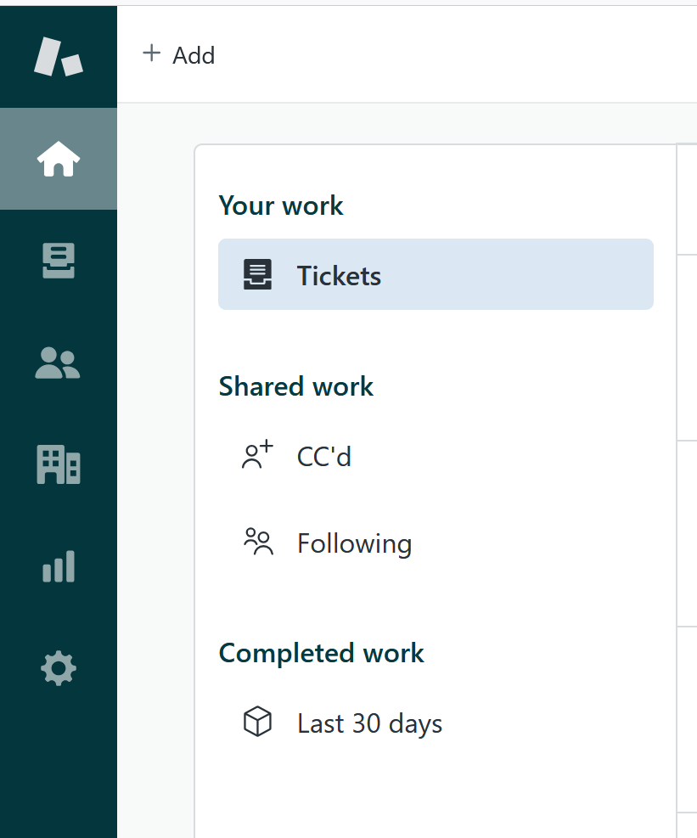
RI#1: Zendesk – Focal point for all support requests
Customer success: Monthly Support Report - June 2025
🛠️ RI#1 Zendesk – Establishing a Unified Entry Point for Support
As Owkin continues to scale, it's essential to align support infrastructure with organizational growth. In May , we plan to finalize the consolidation of all incoming support requests into Zendesk as the primary entry point, reducing fragmentation across Slack, email, and ad-hoc channels.
This effort aims to create a single source of truth for all support interactions, enabling faster response times, clearer ownership, and more consistent reporting.
✅ Key Improvements Implemented in April/May:
🔧 Ticket Visibility Enhancement
• Created a dedicated view for tickets tagged with k-signup-request
• Resolved visibility gaps for API-submitted onboarding tickets
🔧 Welcome Message Automation
• Implemented branded welcome messages for Abstra and Owkin K
• Personalized replies direct Owkin K users to the Help Center
• Messages are instant but do not impact FRT SLA — preserving reporting integrity
🌟 Why This Matters
These changes significantly improve first-touch user experience, reduce confusion, and foster a sense of proactive and structured support, especially as ticket volumes increase.
This foundation sets the stage for future expansion and ensures Zendesk can scale with Owkin's evolving support needs.

Slide 19
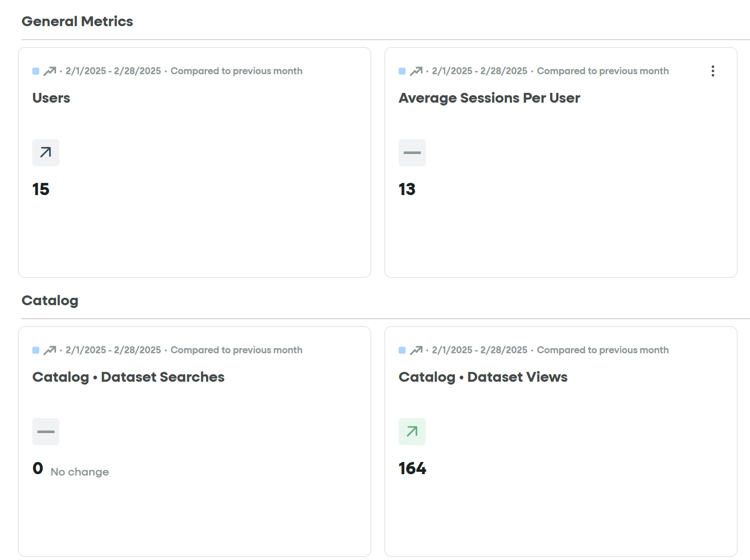
RI#2 Develop a Internal Support Playbook for K-Navigator
Customer success: Monthly Support Report - June 2025
🚀 RI#2 – Launch Internal Support Playbook
Structured Support for K-Navigator Tickets
Objective
Establish a clear and scalable process for handling K-Navigator requests, enabling faster onboarding and consistent triage.
Why it matters
Over 900 K-Navigator tickets processed in the past 2 months (566 in May, 355 in June) — all manually reviewed and approved/rejected.
The current system is stable and effective, with well-coordinated L1/L2 ownership.
The playbook will provide a stronger foundation for growth, speed up agent onboarding, and unify ticket handling logic.
A custom Python script already supports reporting (Excel export, UTC handling, pagination), enabling clear operational visibility.
Expected Impact
Standardized classification and escalation flow.
Faster onboarding for new agents.
Improved consistency across support shifts.
Better automation and analytics through FullStory and internal tools.

Slide 20
Agenda
1
Part I: Abstra support key metrics
2
Part II: Achievements & roadmap
3
Part III: Roadmap items
deep dive
4
Part IV: Product Insights
5
Part V: Next steps

Slide 21
Next steps for Customer Success
Customer success: Monthly Support Report - June 2025
Deliver excellent customer service
→ Maintain <20 min first response time for K-Navigator tickets with L1/L2 triage rotation.
→ Resolve remaining signup access issues and automate approval flow via Cognito.
→ Continue supporting internal users across Slack/Zendesk with real-time troubleshooting.
Strengthen Zendesk Operations
→ Track and report impact of the 3-strike auto-closure rule and updated ticket classification
→ Finalize and document internal support playbook to standardize L1/L2 handling and speed up onboarding
→ Expand logic-based K-Signup automation to further reduce manual load and scale support capacity
Please do not hesitate to reach out to me for any questions.
Operationalize Insights to Improve Onboarding Experience
→ Use FullStory and ticket data to identify repeat onboarding blockers and common user errors
→ Define escalation thresholds based on behavioral patterns (e.g. repeated failed signups, access loops)
→ Collaborate with product and frontend teams to turn insights into quick interface or flow adjustments
→ Improve guidance for new users based on observed drop-off points and Zendesk feedback tags

Slide 22
Agenda
1
Part I: Abstra support key metrics
2
Part II: Achievements & roadmap
3
Part III: Roadmap items
deep dive
4
Part IV: Product Insights
5
Part V: Next steps

Slide 23
Thank you!

